Slide 1
Milestone Integration Platform Software Development Kit 1.0

Slide 2
Content
Introduction
Product Overview
Technical Introduction
Summary

Slide 3
Introduction and Product Overview
Milestone Integration Platform overview
MIP Integration possibilities
What makes MIP different from the present SDK?
Availability and rollout plan

Slide 4
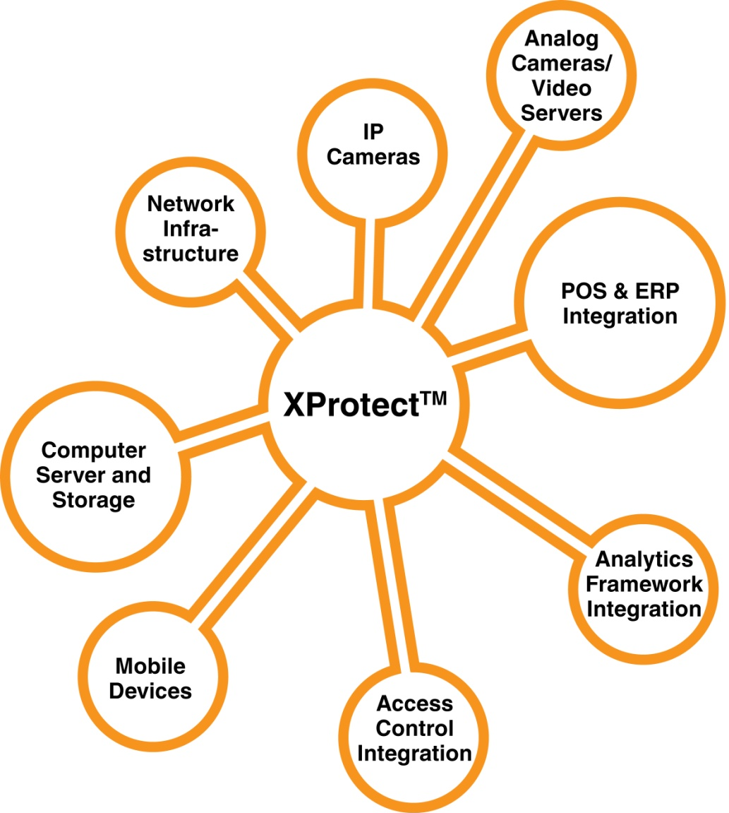
Milestone Integration Platform Introduction
Next generation SDK
Versatile integration possibilities:
Verticalization
Customization
Cornerstone in Milestone Open Platform strategy
Foundation for the 300+ Milestone Solution Partners eco-system
Milestone
XProtect™

Slide 5
Milestone Integration Platform Versatile integration possibilities
Low
High
Protocol Integration
Component Integration
MIP Plug-In
MSP Application
MSP Application
MSP Plug-In
Ease of Integration
MIP Environment
Intuition of Use
MIP Components
XProtect Smart Client
XProtect Management
XProtect™ Professional
XProtect™ Enterprise
XProtect™ Corporate
Milestone Integration Platform
MSP Plug-In
MIP Environment
XProtect™ Event Server
Cameras, I/O Devices and Sensors

Slide 6
What ‘s New in MIP-SDK?
Application plug-in capability via the MIP environment
Management plug-in
Extended Smart Client plug-in with configuration possibilities
Server side plug-in
Full compatibility
XProtect product and version agnostic
MIP SDK forward compatible
Extended SDK capabilities
Comprehensive development toolbox

Slide 7
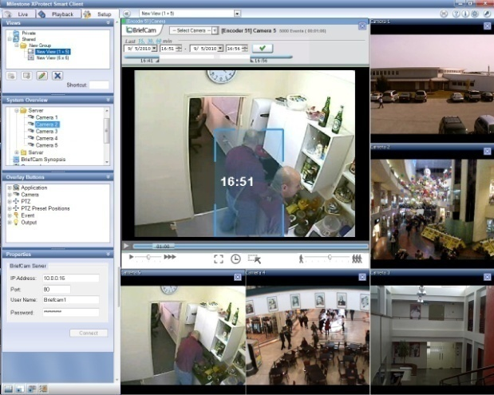
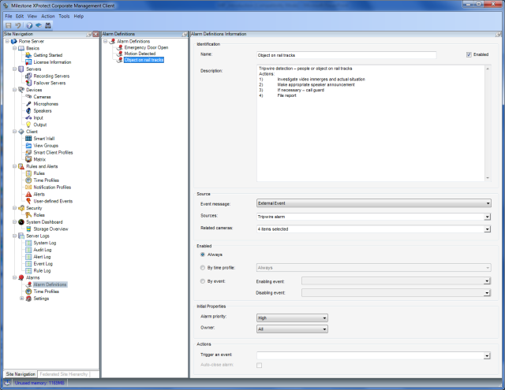
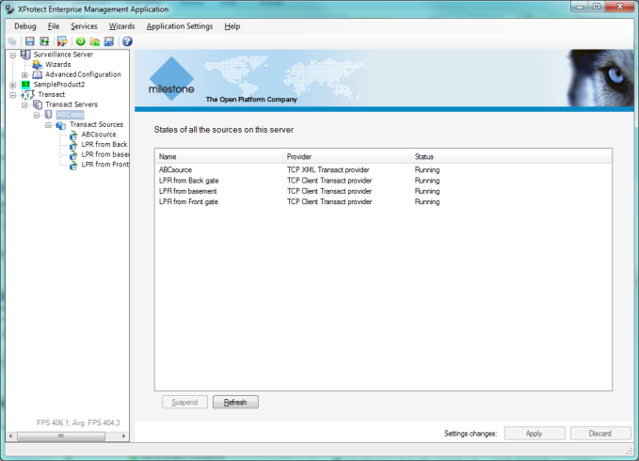
MIP Plug-In – Intuitive Integration Seamless user experience
Share MIP plug-ins between XProtect products
❶
XProtect Smart Client
❷
XPCO Mgmt Client
❸
XPE/XPP Mgmt Application
Milestone Integration Platform
❹
Server side Plug-Ins
MSP Plug-In
MIP Environment
XProtect Event Server

Slide 8
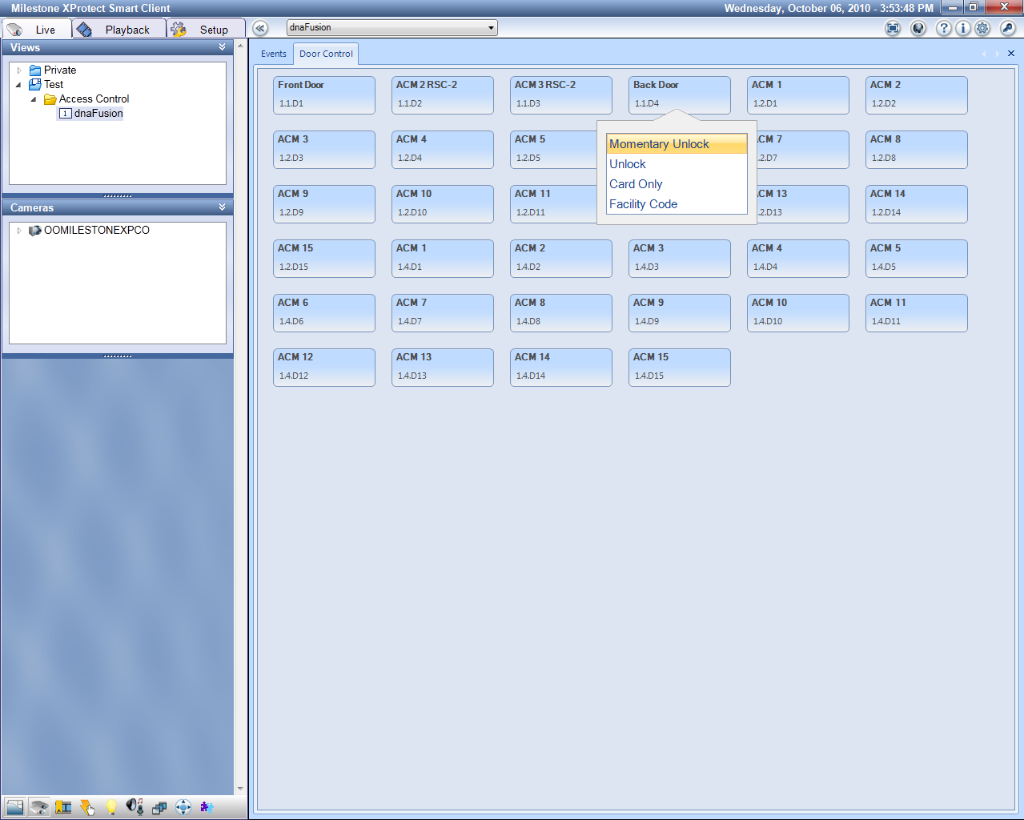
MIP Plug-In Example Open Options Inc. – Access Control
“Working with the new Milestone MIP SDK has been a breeze. I found the SDK layout to be very intuitive and well thought out. This SDK will allow us to deliver an even tighter integrated solution with lots of new features to our customers in a very short time frame.”
- George Crawford, Software Developer, Open Options Inc.

Slide 9
MIP SDK Rollout Plan
MIP 1.0 Beta
MIP 1.0
MIP 2.0
End of Development – Q1’10
End of Support Q4’12
XProtect
Corporate
Milestone SDK
XPA – Analytics Framework 2.1
End of Development – Q2’10
End of Support ?
XPCO 4.0 Beta
XPCO 4.0
XPCO 4.1
MIP 1.0
MIP 2.0
End of Development – Q1’10
End of Support Q4’12
XProtect
Enterprise
Professional
Milestone SDK
XPA – Analytics Framework 2.1
End of Development – Q2’10
End of Support ?
XPE/XPP 7.5 Beta
XPE/XPP 7.5
Q4’10
Q1’11
Q2’11
Q3’11
Q4’11
Q4’12

Slide 10
Technical Introduction
MIP SDK Feature Overview
Architecture overview
Applications & samples
Access Control
Analytics Overlay on Video
Methodology change
MIP SDK content
A programming sample – video overlay

Slide 11
Milestone Integration Platform Feature groups
Protocol Integration
Component Integration
MIP Plug-In
MSP Application
MSP Application
MSP Plug-In
MIP Environment
MIP Components
XProtect Smart Client
XProtect Management
XProtect™ Professional
XProtect™ Enterprise
XProtect™ Corporate
Video & Audio
Event & Alarm
Security
Configu-ration
Control
System status
MSP Plug-In
MIP Environment
XProtect™ Event Server
Cameras, I/O Devices and Sensors

Slide 12
MIP SDK 1.0 Features
Video & Audio
Retrieve and display live/recorded video
Retrieve and play live/recorded audio
Retrieve and display single frame JPEG images
Video and Audio export in both AVI and Milestone Video database format
Place overlay information on live/recorded video in component based implementation as well as Smart Client plug-in
Event & Alarm
Trigger internal or external events and alarms
Retrieve list of triggered events
Security
Manage user rights on plug-in functionality
Framework for system access and security token handling
Configuration
Retrieve VMS configuration including Camera, User and alarm information
Save and retrieve MIP Plug-in configuration
Control
Send PTZ commands to devices
Retrieve PTZ position from absolute PTZ cameras
Send a start or stop recording event from a specific device
Activate external output
Control Smart Wall functionality
Send camera to a Matrix monitor
Send command messages to MIP SDK plug-ins
System Status
Receive all status messages from the VMS system including server disk and CPU usage and all triggered events

Slide 13
Milestone Integration Platform Architecture Overview
MIP Environment interfaces
Abstraction
Layer
Configuration
Client
Data
Login
UI
Export
Messaging
Utility
Security
Background
Protocol Integration
Component Integration
MIP Plug-In
Component interfaces
Component
Layer
Image
Viewer
Audio
Player
Image
Export
Engine
Manager
DirectShow
Filter
Milestone
SDK 3.5
Feature set
Image
Viewer
Audio
Player
Image
Export
Engine
Manager
DirectShow
Filter
Protocol interfaces
Protocols
Layer
Server Command
Recorder
Command
Image
Server
Central
Status
Transact
Server Command
Recorder
Command
Image
Server
Central
Status
Transact
Alarm
Network protocols: TCP/IP, HTTP, Soap

Slide 14
Feature / Layer Matrix
Layer | Function | Video & Audio | Event & Alarm | Security | Configuration | Control | System Status
 | Configuration |  |  |  | 
 | Client |  |  |  |  | 
 | Data |  | 
 | Login |  |  | 
 | UI |  |  |  | 
 | Export | 
 | Messaging |  |  |  |  | 
 | Utility |  |  |  | 
 | Security |  |  | 
 | Background |  |  |  |  | 
 | Image Viewer |  |  |  |  | 
 | Audio Player | 
 | Image export | 
 | Engine Manager |  |  |  | 
 | DirectShow filter | 
 | Server Command |  |  |  |  | 
 | Recorder Command |  |  |  |  | 
 | Image Server |  |  |  |  | 
 | Central |  |  |  |  |  | 
 | Status |  |  |  |  |  | 
 | Transact |  |  |  | 
 | Alarm |  | 
MIP Abstraction Layer
Component Layer
Protocol Layer

Slide 15
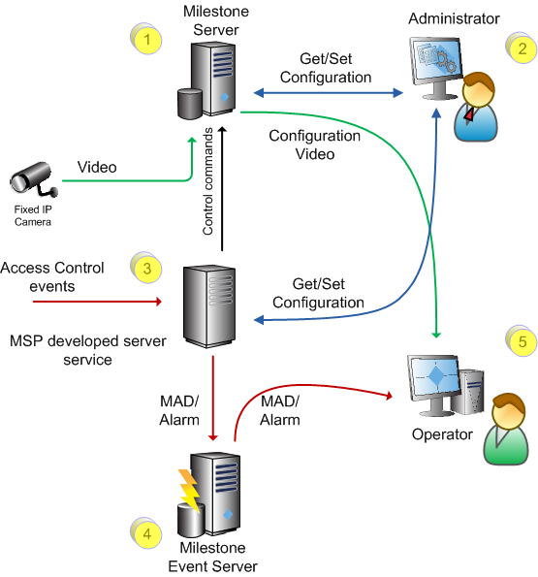
Access Control Applications & Samples
Development at (2)
Configure Sensor to Camera relations
Send configuration to MSP server
Development at (3)
Send event in MAD format
Retrieve configuration
Sensor / camera relationship
IP address for Event Server

Slide 16
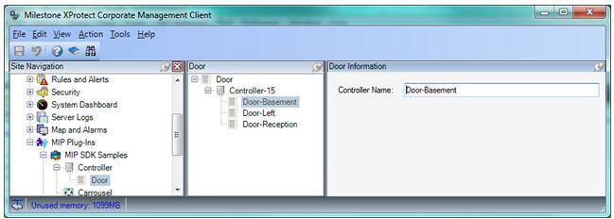
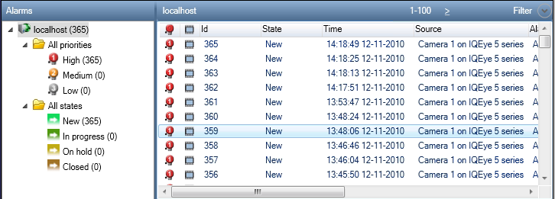
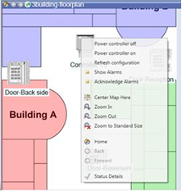
Access Control Applications & Samples
A few 100 lines of code turns left hand application to right hand side solution

Slide 17
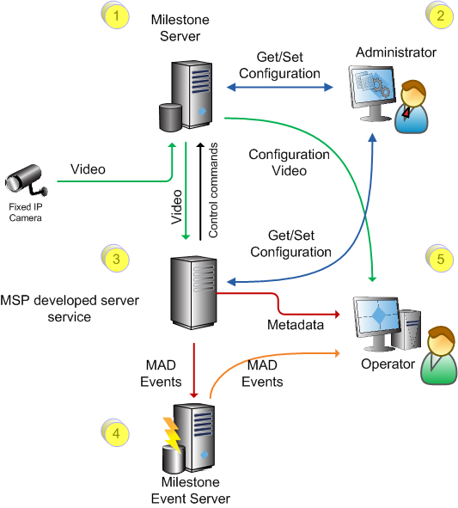
Smart Client video analytics overlay Applications & Samples
Development at (2)
Configure analytics / camera relationship
Development at (3)
Send event in MAD format
Store analytics metadata indexed by camera and time
Be able to deliver analytics metadata
Development at (5)
Retrieve analytics metadata from (3)
Place analytics metadata as overlay on video

Slide 18
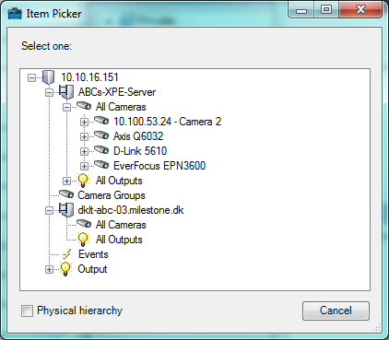
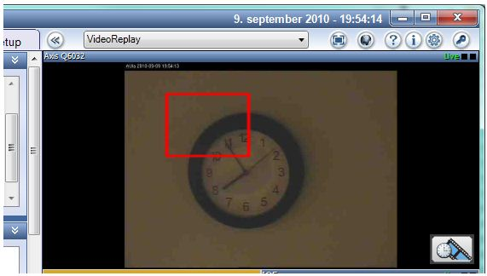
Smart Client video analytics overlay Applications & Samples
Overlay can easily be applied on existing CameraViewItem and standalone ActiveX

Slide 19
Methodology Change Control of activation – a sample
The MIP SDK way to activate
EnvironmentManager.Instance.SendMessage(
new Message(_messageId), _item.FQID);
Type of Command
Item to perform the command on
MessageId.Control.TriggerCommand
MessageId.Control.StartRecordingCommand
MessageId.Control.StopRecordingCommand
Typical Milestone built-in Item types:
Camera
Outputs (Dry contacts)
AUX
Presets
PTZ
User defined event

Slide 20
Methodology Change Unification
Control and commands unified
Activated same way across different Item types
Camera, Output, Event, Matrix, other Plug-ins
Allow end-user to chose what command to trigger on what item
Configuration Items unified
Identification and usage of items inherited from same class
User selection and stored identification works for all item types
Result:
Unified commands can operate on unified Items
Same support for
Smart Client plug-in
Event Server plug-in
MIP .Net Library for standalone applications

Slide 21
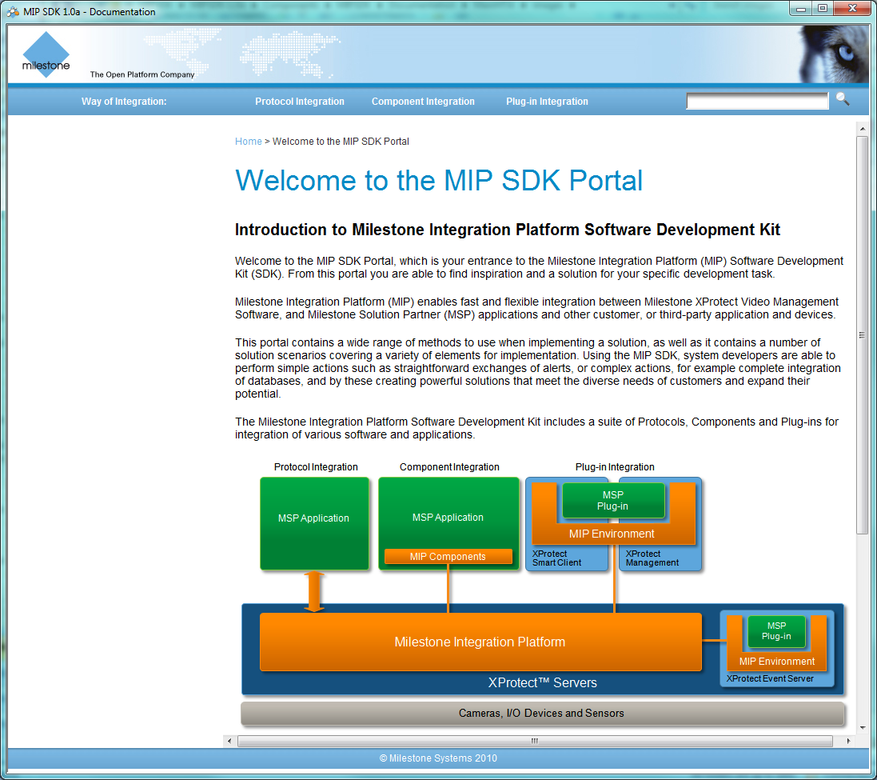
MIP SDK content Documentation
One UI contains all documentation
Search across notes and interface documentation
Documentation divided on key development approach
Protocol
Component
Plug-in

Slide 22
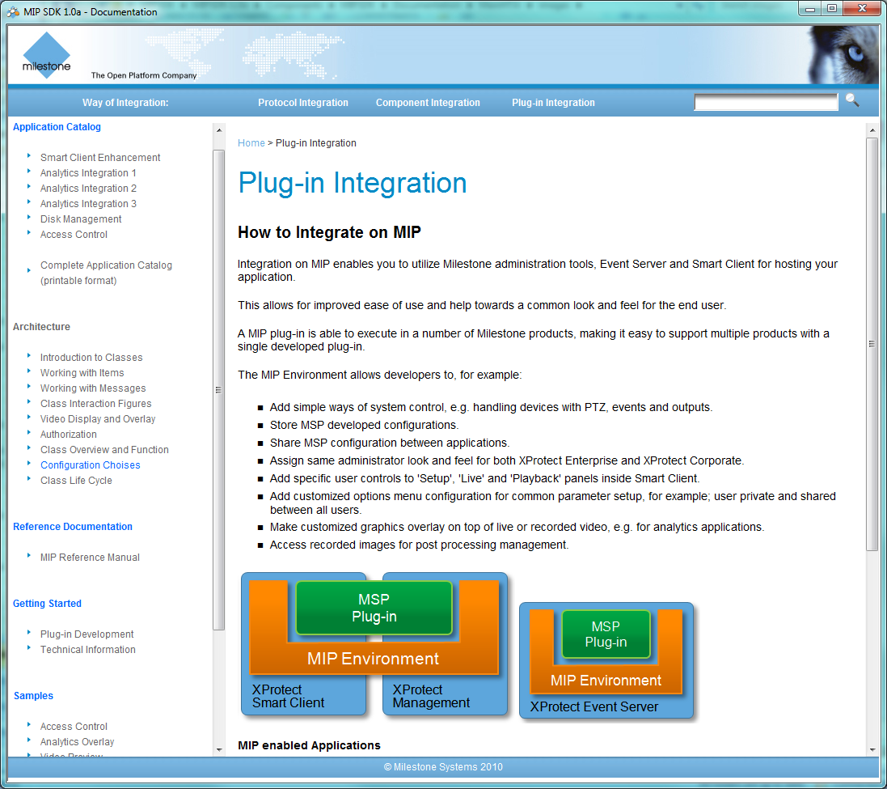
MIP SDK content Documentation – Plug-in Integration
Integration approach content
Application catalogue
Architecture notes
Class reference documentation
Getting started
Samples

Slide 23
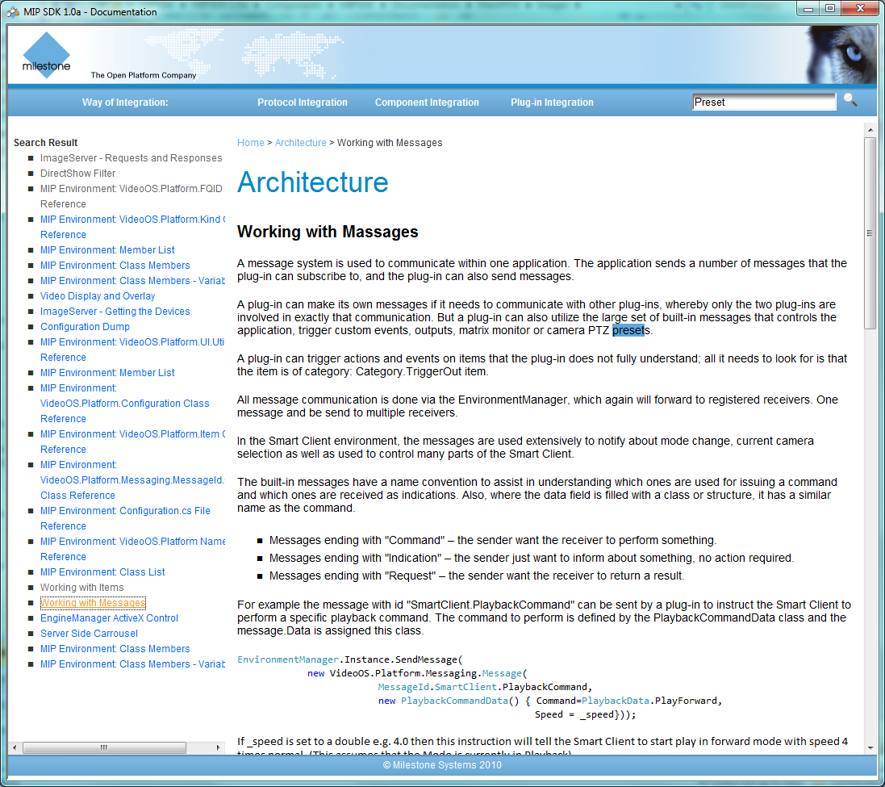
MIP SDK content Documentation - Search
Sample: Search for ‘Preset’
Left hand side contains result
Right hand side contains selected result

Slide 24
MIP SDK content Samples
Protocol
Event Generator
Status Console
Transact Client
Generic Event
TCP Viewer
Component
Configuration Access
Video Viewer
Event Generator
Central
Image Viewer
Plug-in
Access Control
Analytics Overlay
Video Preview
Video Replay
Server Side Carrousel
Data Source
Configuration Dump
Service Test
Message Tester
Smart Client Window Tool

Slide 25
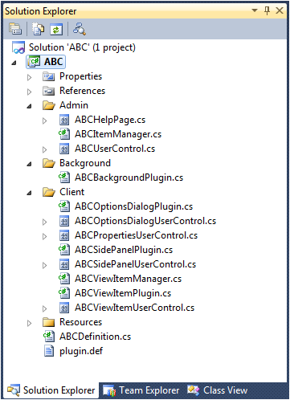
MIP SDK content Visual Studio templates
Available for
VS2010 – Plug-in
VS2010 - Standalone
Contains all key classes to get started
Sample show how it looks when selecting name=“ABC”
Class names modified
GUIDs generated
Can build and execute directly

Slide 26
MIP SDK Code sample - Video overlay
Video overlay sample: Make a square on top of all available video being showed in the Smart Client
Steps:
Create a new solution from template
Add code contained in appendix A (5 steps)
Total of apprx 75 lines of code
Sample shows:
Abstraction from Complex ActiveX interface and versions
Same interface available in Smart Client and MIP .Net Library
Demonstrate how to ‘hook’ on to all video being showed in the Smart Client (Main window, floating window, print, bookmark, …)

Slide 27
Summary
Key Messages
Key Benefits
Getting Started
Key Dates
Who to contact

Slide 28
Key Messages MIP SDK 1.0
Supports a multitude of integration methods
Multiple integration layers with different levels of abstraction
Facilitates different types of application / systems integrations
MIP plug-in enables seamless application integration that gives an ultimate user experience
A world of innovative possibilities
Extensive video and events handling capabilities
Dynamic video overlaying possibilities
Server side MIP integration
Unique intra MIP plug-in communication
Comprehensive development framework
Extensive documentation with application and code samples
Toolbox with proven Milestone libraries and code components
Visual Studio project templates
Development tool (traces, program logs, etc.)
Develop once - apply on all
Unified interface to all Milestone XProtect VMS products
Forward compatible – release agnostic
Automatic access to new capabilities

Slide 29
Key Benefits MIP SDK 1.0
Optimize Your Solution Value
Easy and seamless plug-in of third-party applications
Ability to differentiate in the market and meet customer needs
High customer satisfaction
Shorter Time-to-Market
Automatic access to new capabilities
Reduced solution maintenance cost
Reduced need for support
Increased market reach with unified interface to Milestone VMS
More Powerful and Innovative
Extensive development toolbox with endless possibilities to meet customer needs
Unique features for demonstrating thought leadership

Slide 30
Getting started
MIP SDK 1.0 is available for download per request (partner@milestone.dk)
Sign up for new MIP SDK training sessions
In San Antonio, TX, US on March 1-2, 2011 - prior to the Milestone Integration Platform Symposium (MIPS) US 2011
In Copenhagen in May 2011
In Bangkok, on July 4-5 – prior to MIPS Asia 2011

Slide 31
Key dates
The MIP SDK 1.0 is released on February 8th, 2011
XProtect Enterprise 7.5 including MIP support
Beta release – mid-March 2011
Final release - Q2 2011

Slide 32
Who to contact…
Questions on MIP
Anders B. Christensen (abc@milestonesys.com)
MIP SDK Training
Tine Elm (tel@milestonesys.com)
MSP program
MSP team (partner@milestonesys.com)

Slide 33
Appendix A Code for overlay tutorial
Create a new solution from template
Add code for declaration & initialization
Add code for managing registration
Add code for add/remove new ImageViewerAddOn’s
Add code for camera id changing
Add code for playback overlay update
Add code for live overlay update
Add code for bitmap construction
Note: Samples are for information purpose only. Multithreading issues has been left out for simplicity reasons

Slide 34
MIP Plug-in for analytics video overlay Code sample - step 1
Definition & Initialization
private Collection<ImageViewerAddOn> _activeImageViewerAddOns = new Collection<ImageViewerAddOn>();
public override void Init()
{
ClientControl.Instance.NewImageViewerControlEvent += NewImageViewerControlEvent;
_stop = false;
_thread = new Thread(new ThreadStart(Run));
_thread.Start();
}
public override void Close()
{
ClientControl.Instance.NewImageViewerControlEvent -= NewImageViewerControlEvent;
_stop = true;
}

Slide 35
MIP Plug-in Code sample - 2
Registration
public override List<EnvironmentType> TargetEnvironments
{
get { return new List<EnvironmentType>() { EnvironmentType.SmartClient }; }
}
void RegisterEvents(ImageViewerAddOn imageViewerAddOn)
{
imageViewerAddOn.CloseEvent += ImageViewerAddOn_CloseEvent;
imageViewerAddOn.PropertyChangedEvent += ImageViewerAddOn_PropertyChangedEvent;
imageViewerAddOn.RecordedImageReceivedEvent += ImageViewerAddOn_RecordedImageReceivedEvent;
}
void UnregisterEvents(ImageViewerAddOn imageViewerAddOn)
{
imageViewerAddOn.CloseEvent -= ImageViewerAddOn_CloseEvent;
imageViewerAddOn.PropertyChangedEvent -= ImageViewerAddOn_PropertyChangedEvent;
imageViewerAddOn.RecordedImageReceivedEvent -= ImageViewerAddOn_RecordedImageReceivedEvent;
}

Slide 36
MIP Plug-in Code sample - 3
Code for managing add/remove of new AddOns
void NewImageViewerControlEvent(ImageViewerAddOn imageViewerAddOn)
{
lock (_activeImageViewerAddOns)
{
RegisterEvents(imageViewerAddOn);
_activeImageViewerAddOns.Add(imageViewerAddOn);
}
}
void ImageViewerAddOn_CloseEvent(object sender, EventArgs e)
{
ImageViewerAddOn imageViewerAddOn = sender as ImageViewerAddOn;
if (imageViewerAddOn != null)
{
UnregisterEvents(imageViewerAddOn);
if (_activeImageViewerAddOns.Contains(imageViewerAddOn))
{
lock (_activeImageViewerAddOns)
{
imageViewerAddOn.ClearOverlay(12);
_activeImageViewerAddOns.Remove(imageViewerAddOn);
}
}
}
}

Slide 37
MIP Plug-in Code sample - 4
Maintenance & Playback overlay update
void ImageViewerAddOn_PropertyChangedEvent(object sender, EventArgs e)
{
ImageViewerAddOn imageViewerAddOn = sender as ImageViewerAddOn;
if (imageViewerAddOn != null)
{
imageViewerAddOn.ClearOverlay(12);
}
}
//Draw overlay in playback mode
void ImageViewerAddOn_RecordedImageReceivedEvent(object sender, RecordedImageReceivedEventArgs e)
{
ImageViewerAddOn imageViewerAddOn = sender as ImageViewerAddOn;
if (imageViewerAddOn != null)
{
DrawOverlay(imageViewerAddOn, imageViewerAddOn.CameraFQID, e.DateTime);
}
}

Slide 38
MIP Plug-in Code sample -4
Live update of overlay bitmap
private void Run()
{
EnvironmentManager.Instance.Log(false, "ABC background thread", "Now starting...", null);
while (!_stop)
{
if (_activeImageViewerAddOns.Count > 0)
{
lock (_activeImageViewerAddOns)
{
foreach (ImageViewerAddOn addOn in _activeImageViewerAddOns)
{
if (addOn.CameraFQID != null && addOn.InLiveMode)
{
//Only draw the ones in Live mode
DrawOverlay(addOn, addOn.CameraFQID, DateTime.Now);
}
}
}
}
Thread.Sleep(1000);
}
EnvironmentManager.Instance.Log(false, "ABC background thread", "Now stopping...", null);
_thread = null;
}

Slide 39
MIP Plug-in Code sample -5
private void DrawOverlay(ImageViewerAddOn addOn, FQID cameraFQID, DateTime dateTime)
{
Bitmap bitmap = ConstructBitmapOverlay(cameraFQID, dateTime);
addOn.SetOverlay(bitmap, 12, false, true, true, 1.0, System.Windows.Forms.DockStyle.None,
System.Windows.Forms.DockStyle.None, 0.0, 0.0);
bitmap.Dispose();
}
private Bitmap ConstructBitmapOverlay(FQID cameraFQID, DateTime dateTime)
{
Brush brush = new SolidBrush(Color.Transparent);
Bitmap bitmap = new Bitmap(100, 100);
Graphics g = Graphics.FromImage(bitmap);
g.FillRegion(brush, new Region(new Rectangle(0, 0, 100, 100)));
//Here we should add the real code to find relevant info for
// CameraId=cameraFQID at time=dateTime
int s = dateTime.Second % 10;
g.DrawRectangle(Pens.Red, s * 5, s * 5, 30, 30);
g.Dispose();
return bitmap;
}

